Slide 1
Setting Goals for the county farm bureau

Slide 2
Introduction
What are Goals? Why a should a County farm Bureau have goals? Where do you start?
This presentation will help you understand how your County Farm Bureau board can set 5 goals that are clear, measurable, and achievable.
Notes:
How presentation will benefit audience: Adult learners are more interested in a subject if they know how or why it is important to them.
Presenter’s level of expertise in the subject: Briefly state your credentials in this area, or explain why participants should listen to you.

Slide 3
What is a goal?
A goal can be defined as a desired result envisioned by a person or group and accompanied by an effort aimed at achievement.
Notes:
Example objectives
At the end of this lesson, you will be able to:
Save files to the team Web server.
Move files to different locations on the team Web server.
Share files on the team Web server.

Slide 4
Goals should be Specific
Is the goal clearly written, without uncertainty? Does it clearly state who is involved and any support they might need?
Notes:
Example objectives
At the end of this lesson, you will be able to:
Save files to the team Web server.
Move files to different locations on the team Web server.
Share files on the team Web server.

Slide 5
Goals should be achievable
Can you get the support and resources needed to achieve the goal by the target date?
Are the expected results realistic?

Slide 6
Goals should be Measurable
Does the goal answer the questions of how many, how much and/or how often?

Slide 7
Goal Setting Strategy
Notes:
Lesson descriptions should be brief.

Slide 8
What the goal should be:
No more than 2-3 sentences
Include exactly what needs to be accomplished
Completion date
How will the goal be done?
How will you know the goal is done?
Who oversees completing the goal?

Slide 9
Why is the goal important?
Why does it matter to your County Farm Bureau?
Is it a personal goal of the manager and/or board?
Is it a goal that will affect the future of the CFB?
How will the accomplished goal affect the County Farm Bureau organization?

Slide 10
Potential problems or complications in completing the goal
List potential problems, issues, and complications in completing goals.
If there are potential issues, what is the “if-then” statement? This keeps you on track to complete your goals.
By realizing potential problems this keeps the entire goal from failing.

Slide 11
Completion date of goal
Target date of completion.
Provides reaffirmation of the goal and the importance of completing.

Slide 12
Action Items of Goals
List of what needs to be done.
Tasks for each individual/group involved.
When is it going to be completed?

Slide 13
Now it’s your turn!
Develop 5 goals together with your County Farm Bureau Board of Directors
Example:
Goal #1 for Sample County Farm Bureau
Achieve a Membership Quota for 2020.
Meet 75% of Quarterly Membership Goals to help with year-end quota.
Each Board Member will write 2 new Voting Members before membership year-end.
Teacher Postcard Membership Campaign for Associate membership drive.
NOW YOU TRY ONE………

Slide 14
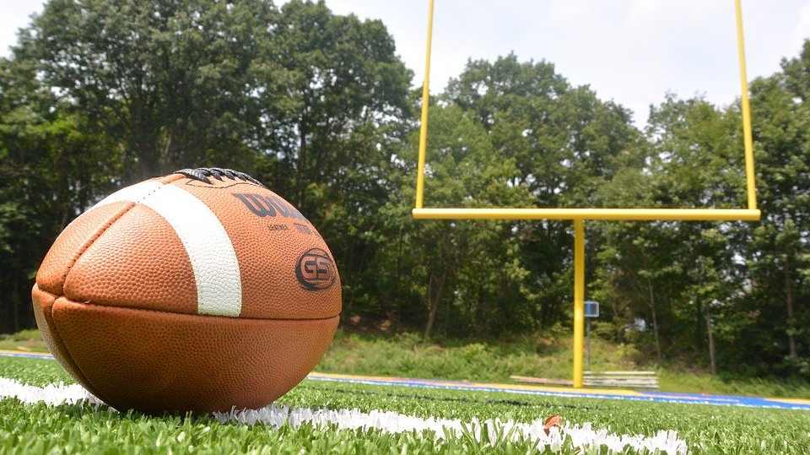
you now have the first goal! NOW SHOW US YOUR Goal 2,3,4 and more

Slide 15
Ready set goal!
If you need help in setting goals with your County Farm Bureau Board of Directors, you can contact the Training & Development Department for more information at (309) 557-3943 or training@ilfb.org.

